Slide 1
Synergy in
Mergers & Acquisitions
Theory and Practice in Central Europe
October 24 2002
CESP, VŠE in Prague
Marek JINDRA, M.A.

Slide 2
Content Overview
M&As as an Economic Phenomenon
Reasons and Impetus of M&As
Synergy – a Quest for Holy Grail
Synergy Drivers
Value Estimation in M&A Decision Making – technical issues
Central European M&As – a case study
October 24 2002
Synergy in Mergers & Acquisitions

Slide 3
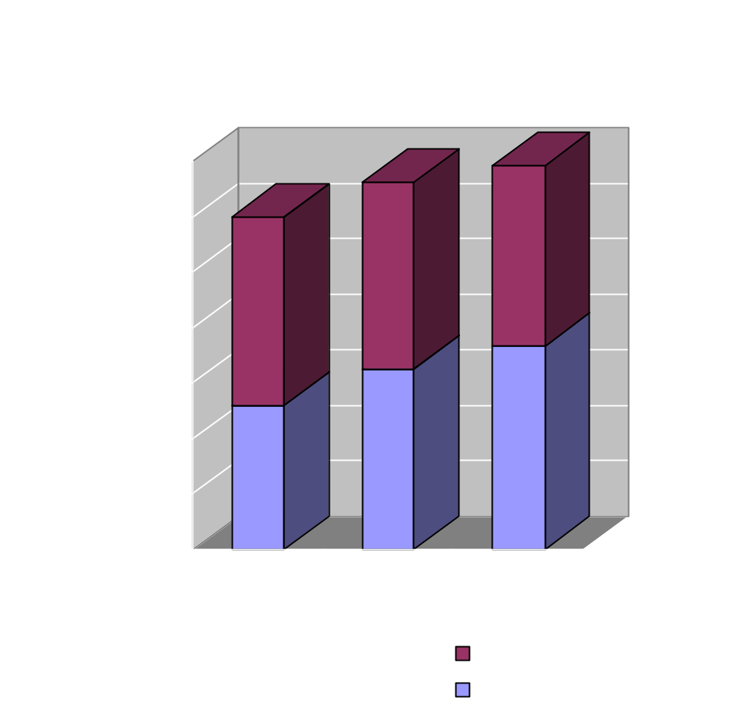
Mergers & Acquisitions as an Economic Phenomenon
Trillion dollar business
Rapid increase in volume
Multinational dimension
A way how to expand rapidly
Monopoly
Value Destruction
More Qs than answers
October 24 2002
Synergy in Mergers & Acquisitions

Slide 4
Mergers & Acquisitions as an Economic Phenomenon – cont’d
Empirical evidence on M&A over last decades:
The majority of the studies report that there has been a significant proportion of M&A failures over last five decades since the waves of mergers (MAE grounds) started
Actual success rate varies but ballpark figure could be ca. 50%
However, some studies are very alarming:
1) Millman and Grey show that “…83% of mergers produce no benefit whatsoever to shareholders”
2) Sirower finds 60-70% of acquisitions failing to produce positive returns.
October 24 2002
Synergy in Mergers & Acquisitions

Slide 5
Mergers & Acquisitions as an Economic Phenomenon – cont’d
Change in character of M&As over time:
From cost-saving to revenue-increasing
Increasing average $ value per transaction whole 1980s – 35,000 TA @ total $3 trillion 2000 – 20,000 TA @ total $3,3 trillion
From domestic to cross-border M&As in 1990s
Mean of payment changes in waves according to MAE conditions
October 24 2002
Synergy in Mergers & Acquisitions

Slide 6
Reasons and Impetus of M&As
A strategic way how to expand the business and create a value for shareholders
A way for management how to extend its influence, thus compensation – „empire building“ (Transaction Theory - Williamson)
October 24 2002
Synergy in Mergers & Acquisitions

Slide 7
Reasons and Impetus of M&As – cont’d
Theoretical explanations for M&A activity outcomes:
Synergy Theory – expects that there is really “something out there” which enables the merged entity to create shareholders value
Managerialism Theory – claims that these combinations are driven by empire building not by shareholders wealth objective
Managerial Hubris – while following the SWO managers make unconscious mistakes being overconfident about transportability of their successfulness
COMParable AcQuisitions – legal issue; shareholders of target are protected by the law, while acquirer’s shareholders are not
October 24 2002
Synergy in Mergers & Acquisitions

Slide 8
Synergy – a Quest for Holy Grail
WHAT IS IT?
Popular definition: 1 + 1 = 3
Roundabout definition: If am I willing to pay 6 for the business market-valued at 5 there has to be the Synergy justifying that
More technical definition: Synergy is ability of merged company to generate higher shareholders wealth than the standalone entities
October 24 2002
Synergy in Mergers & Acquisitions

Slide 9
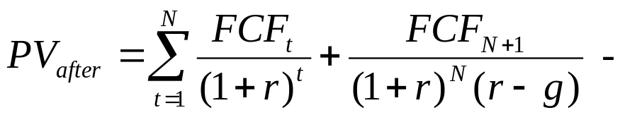
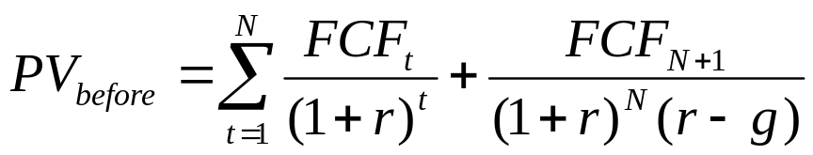
Synergy – a Quest for Holy Grail
WHAT IS IT? – cont’d
Mathematically: Synergy =
Economically:
Ability to further limit competitors’ ability to contest their or the targets’ current input markets, processes, or output markets, and/or
Ability to open markets and/or encroach on their competitors’ markets where these competitors cannot respond.
October 24 2002
Synergy in Mergers & Acquisitions

Slide 10
Synergy – a Quest for Holy Grail
SIROWER:“Suppose you are running at 3 mph, but are required to run 4 mph next year and 5 mph the year after. Synergy would mean running even harder than this expectation while competitors supply a head wind. Paying a premium for synergy – that is, for the right to run harder – is like putting on a heavy pack. Meanwhile, the more you delay running harder, the higher the incline is set. This is the acquisition game.”
Not understanding the essentials may be described as (Stern):
“Paying unjustified premiums is tantamount to making charitable contributions to random passers-by, never to be recouped by the buying company no matter how long the acquisition is held.”
October 24 2002
Synergy in Mergers & Acquisitions

Slide 11
Synergy – a Quest for Holy Grail
Lessons from history:
Quaker Oats bought in 1994 Snapple for $ 1,7 bn.
$ 500 mil. lost on announcement, $ 100 mil. a year later
Snapple was spun off 2 years later at 20% of price
Anheuser-Busch bought in 1982 Campbell-Taggart at $ 560 mil
closed down after 13y of struggling for survival
IBM bought Lotus for $ 3,2 bn. (more than 100% premium)
probably never to be recouped
October 24 2002
Synergy in Mergers & Acquisitions

Slide 12
Drivers of Synergy
INITIAL FACTORS INTERNAL FACTORS
Method of Payment
Operations
Strategic Relatedness
System Integration
Control and Culture
Contested vs. Uncontested
Acquisition Premium
SYNERGY
Strategy
Relative Size
Managerial Risk Taking
Time
October 24 2002
Synergy in Mergers & Acquisitions

Slide 13
Strategic relatedness
Acquisition
unrelated - strategic
cross-sector
related
complementary
horizontal
competitive
vertical
October 24 2002
Synergy in Mergers & Acquisitions

Slide 14
Strategic relatedness – cont’d
Cross-selling
Customer-based Geographically-based
? ?
same territory different territory
distinct groups of customers similar groups of customers
=> cross-sector acquisition => horizontal-complementary acquisition
X
for horizontal-competitive: same territory, same group of customers
A
B
A
B
Customers of A-company
Customers of B-company
Area operated by A-company
Area operated by B-company
October 24 2002
Synergy in Mergers & Acquisitions

Slide 15
Strategic relatedness – cont’d
Loral corporation & LockheedMartin
(McDonnelDouglas switched to Raytheon)
Chevron & Texaco
First Union Corp. & Money Store subsidiary
Conseco & Green Tree Financial Corp.
First Union Corp.& Wheat First
October 24 2002
Synergy in Mergers & Acquisitions

Slide 16
Mergers vs. Tender offers and Contested vs. Uncontested deals
mergers vs. tender offer
contested vs. uncontested
white knights phenomenon
    compared to friendly and hostile bidders resp.
    benefits payoff scheme is even more skewed to target’s shareholders
    WK lose significantly more than subsequent hostile bidders
October 24 2002
Synergy in Mergers & Acquisitions

Slide 17
Method of payment
Cash vs. stocks
asymmetric information and market’s rational reaction
stock-financed transactions punished
waves of stock purchases, related to the MAE situation and market’s mood
stock purchase looks to be something “free” BUT on well-working markets it is NOT
October 24 2002
Synergy in Mergers & Acquisitions

Slide 18
Relative size
how to measure it? MV, turnover, employees,…
=> directly comparable only horizontal M&A
empirical evidence proves to be right only for massive differences in size
no strong support for difference in sizes to be significant
DEFENSIVE MERGERS
October 24 2002
Synergy in Mergers & Acquisitions

Slide 19
Internal Factors
Strategy
Operations
System Integration
Control and Culture
October 24 2002
Synergy in Mergers & Acquisitions

Slide 20
Strategy
Vision
AT&T’s vision for the NCR acquisition “to link people, organizations and their information in a seamless global computer network”
Viacom’s vision for CBS acquisition “to become premier globally branded content provider” are a few examples.
But customers do not have to get it:
Sears & Dean Witter Reynold/Coldwell bankers: „to deliver to customers all financial services, ranging from insurance, credit and real estate to financial instruments such as equities and commercial papers at Sears Centers under one roof with sport equipment, home appliances, flowers, car rentals and others“
October 24 2002
Synergy in Mergers & Acquisitions

Slide 21
Strategy – cont’d
Two kinds of strategic synergy
Materializes without a changes in actual operations or in the manner of doing business (financial benefits, increased pricing power on both input and output side or benefits from cross-border acquisitions)
Synergy POTENTIAL
There are NO purely strategic reasons, NO „perfect fit“
Harry Tempest from ABN AMRO says: “We have a rule on the Executive Committee: When someone says ‘Strategic’, the rest of us say ‘too expensive’”
Defensive mergers
October 24 2002
Synergy in Mergers & Acquisitions

Slide 22
Operational Implementation
detailed planning is necessary
two ways:
Cost-saving („hard synergy“)
redundancies – admin, production, logistics, …
Revenue-enhancement („soft synergy“)
cross selling,
strength-strength & strength-weakness matching
October 24 2002
Synergy in Mergers & Acquisitions

Slide 23
System integration
can be a very significant limiting factor of many well-planned acquisitions
Examples:
  Burroughs and Sperry – Unisys – 90% down
  Chemical Bank and Manufacturers Hanover – 2y
  Special issue – Pricing system
  ensure that the pricing system is CONSISTENT
October 24 2002
Synergy in Mergers & Acquisitions

Slide 24
Control & culture
Have become increasingly the most CRITICAL SUCCESS FACTOR in recent transactions
difficult to define and control:
“shared set of norms (both formal and informal), values, beliefs and expectations” or
as “an interconnected composite of values, work rituals and leadership”
Too aggressive culture integration doomed acquisition of Montgomery securities by Nations Bank Corp. in 1997. Less than a year and half later Montgomery securities founder Thomas Weisel left, taking 100 of his best investment bankers with him.
October 24 2002
Synergy in Mergers & Acquisitions

Slide 25
Control & culture – common mistakes
Management withdraw and become distant
Inconsistent messages and behaviour
Communication disconnects from maintaining performance and focuses excessively on persuading employees to feel good
Communication is only top-down process
Talented and the most perspective employees leave as they do not identify themselves with new entity
Referral problem
Leadership appointments – co-CEOs, …
…..
October 24 2002
Synergy in Mergers & Acquisitions

Slide 26
Managerial Risk Taking
Irrationality in managers’ decision-making when an M&A goes wrong
- managerial hubris
- risk escalation
(asymmetric risk response, gamblers’ behaviour)
Difficult to empirically prove
  - operationalization problem (initial risk set-up, changes)
  - other than synergy or hubris hypothesis
October 24 2002
Synergy in Mergers & Acquisitions

Slide 27
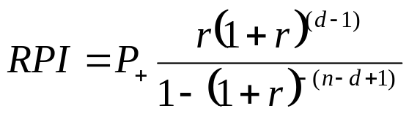

Value Estimation in M&A Decision Making – technical issues
time is crucial and can undermine even well prepared transactions if not considered
quite often underestimated of not understood
MODEL: for infinity
October 24 2002
Synergy in Mergers & Acquisitions

Slide 28
Value Estimation in M&A Decision Making – technical issues (cont’d)
SEE GRAPHS
October 24 2002
Synergy in Mergers & Acquisitions

Slide 29
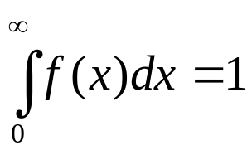
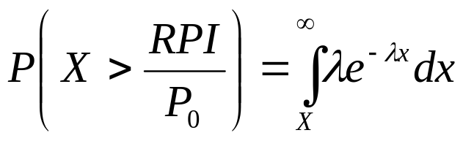
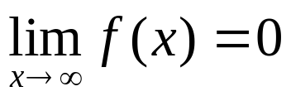
Value Estimation in M&A Decision Making – technical issues (cont’d)
PROBABILITY MODEL:
1.f(x) is continuous
2.
3.
4.f(0) > 0
5.f(x) is nonincreasing in x
October 24 2002
Synergy in Mergers & Acquisitions

Slide 30
Value Estimation in M&A Decision Making – technical issues (cont’d)
SEE GRAPHS
October 24 2002
Synergy in Mergers & Acquisitions

Slide 31
Central European M&As
– Macroenomic Framework
mainly unidirectional
low competitive markets with comparatively higher growth potential (situation of 1990s)
economies-wide privatization
relatively high-skilled labor
markets for corporate control too small to be effective
synergies stemming most importantly from bridging the techgap
BUT environment specific to the MAE conditions
BUT different work attitude for historical reasons
October 24 2002
Synergy in Mergers & Acquisitions

Slide 32
Central European M&As
– a Case Study
two construction companies:
Slovakian acquirer and Czech Target
horizontal – complementary acquisition
price paid according to market value (objective x subjective)
a few years of preceding cooperation
cultural similarity
Slovaks grabbed the opportunity
October 24 2002
Synergy in Mergers & Acquisitions

Slide 33
Cornerstones of Synergy
Strategy: financing, revenue enhancement
Operations: joint contracts acquiring, cross-referencing
joint PPE acquiring
Systems: core problem – to support the above pillars
management lines, ICT systems
Culture: enabled by cultural affinity and preceging co-op.
challenge: to make people cooperate also on lower management levels
create a “Code of Joint Working”
October 24 2002
Synergy in Mergers & Acquisitions

Slide 34
Outcomes
As a result of “opportunity acquisition” the change has been managed accidentally (at least in first year), looking for areas where and how to cooperate
“common sense” used in transition management, empirical evidence ignored
no clear controllable targets set
Well working referencing on top level – crucial in the business
ABOVE ALL:
The acquisition is ultimately successful in terms of EAT
October 24 2002
Synergy in Mergers & Acquisitions

Slide 35
Questions ?
October 24 2002
Synergy in Mergers & Acquisitions

Slide 36
Thank you for attention
Contact: marek.jindra@ey.cz
October 24 2002
Synergy in Mergers & Acquisitions

